Slide 1
Deep learning term project Image classification
Sai vishal tyagadurgam

Slide 2
Introduction
The basic concept of image classification is the identification of pixels with similar characteristics, and the aggregation of these pixels into classes.
Image classification is the most important use case in digital image analysis
Image classification is an application of both supervised and unsupervised classification
In supervised we select samples of each target class. We train our neural network on these samples and then classify new samples
In unsupervised, we group sample images into clusters of images having similar properties. Then we classify each cluster into our intended classes

Slide 3
Dataset description
CIFAR-10 is the dataset I used for this project.
This is one of the popular computer vision dataset.
It is well studied in many types of deep learning research for object recognition.
This dataset consists of 60000 images divided into 10 classes, with each category containing 6000 images.
These images are of shape 32*32
Airplane, Cat, Bird, Car, Dog, Deer, Frog, Horse, Ship, Truck are the 10 different classes of this dataset.

Slide 4
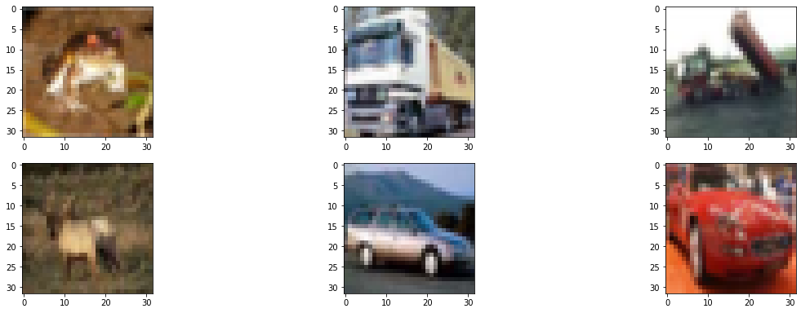
This dataset contains images of a very low resolution, which allows researchers to try new algorithms.

Slide 5
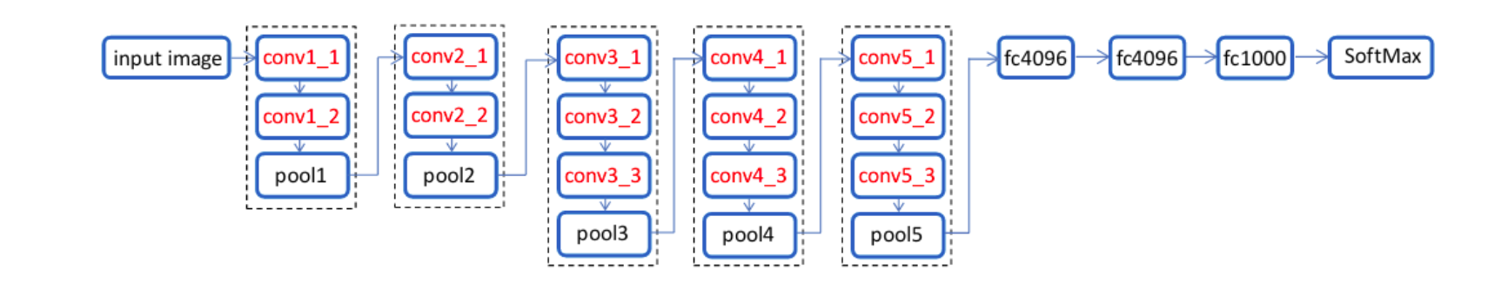
Neural network
I have used sequential model for this network.
The network consists of 16 layers
The model has 550,570 number of trainable parameters

Slide 6
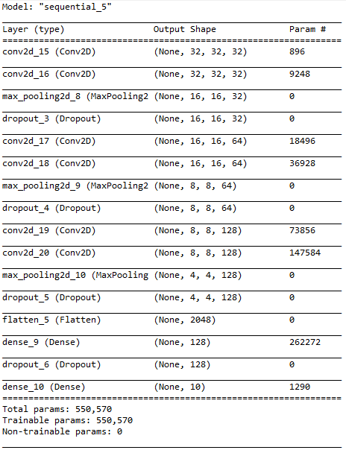
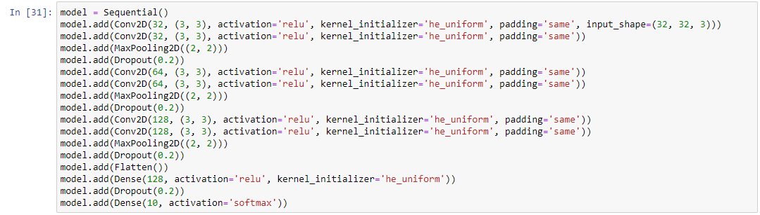

Slide 7
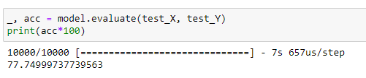
This model is compiled with categorical cross entropy loss function and SGD(Stochastic Gradient Decent) optimizer.
It is fitted with 15 epochs and a batch size of 32
The model performed well with an accuracy of 77.7%
This model took 1990 seconds (33 minutes) to train.

Slide 8
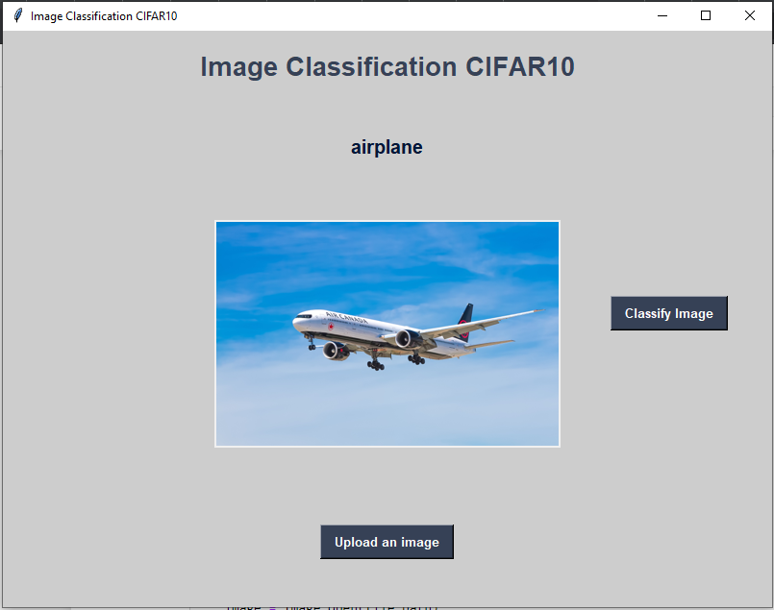
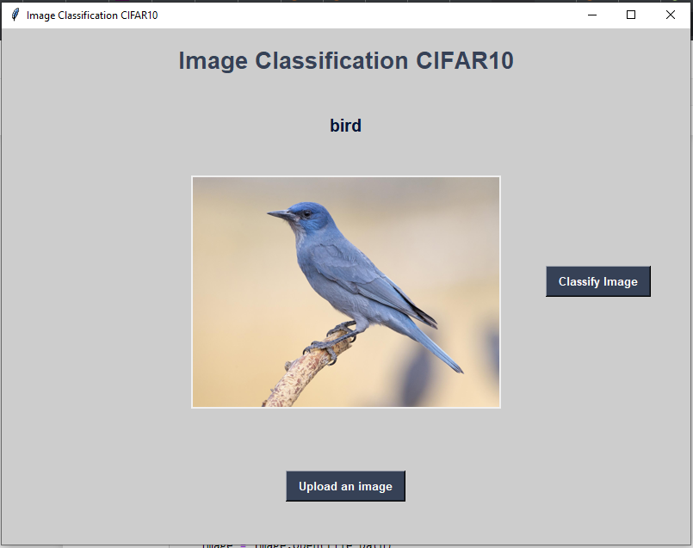
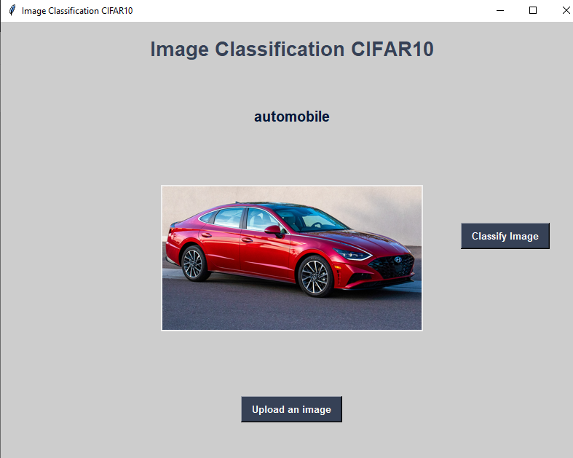
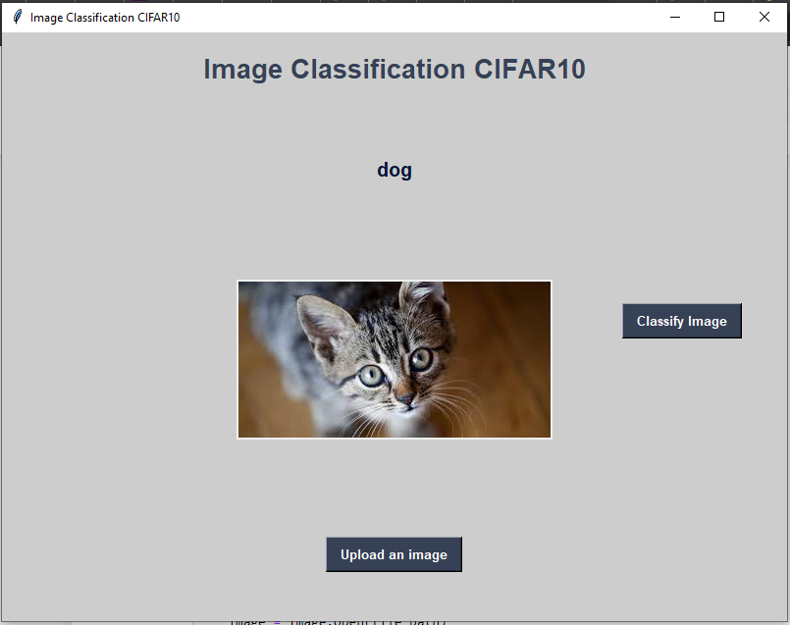
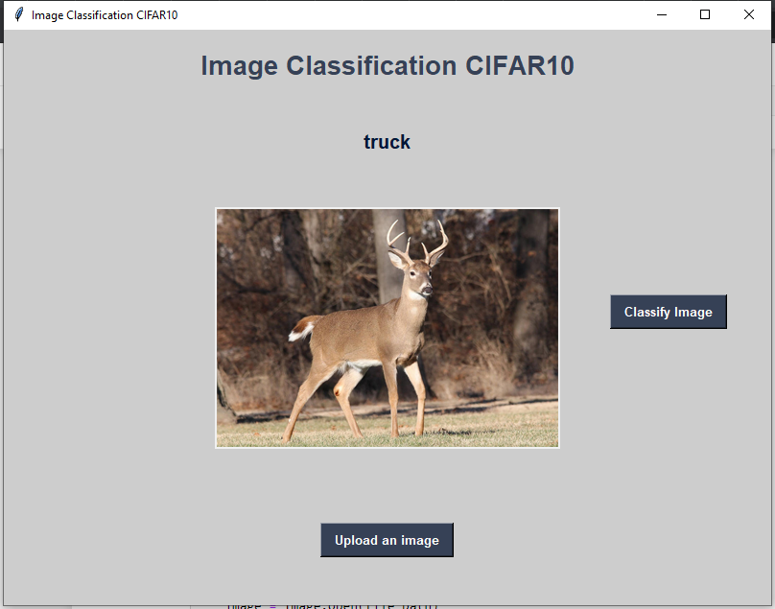
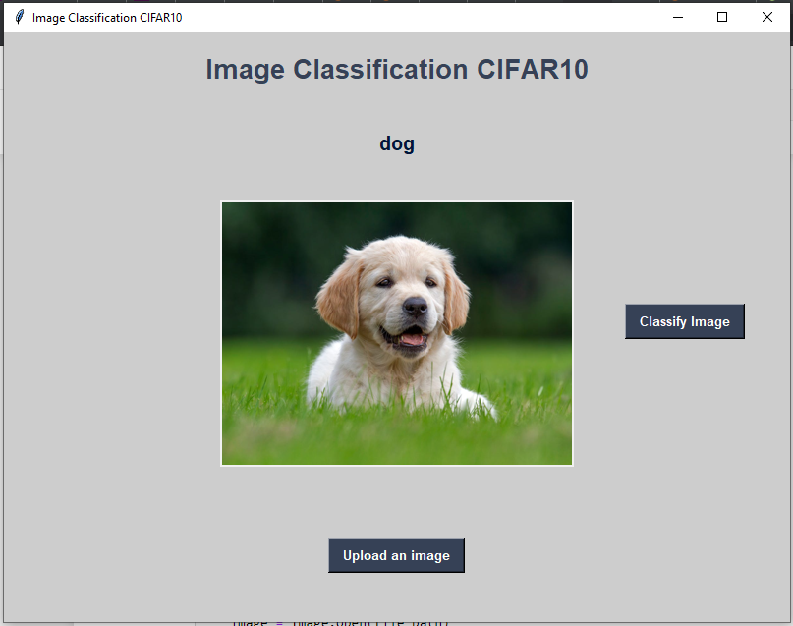
Results

Slide 9
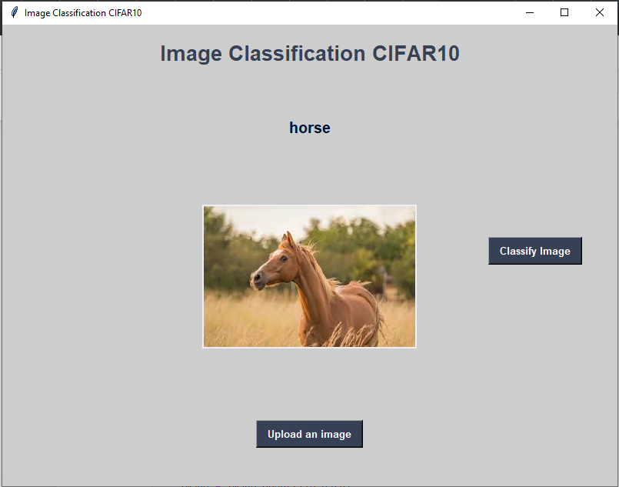
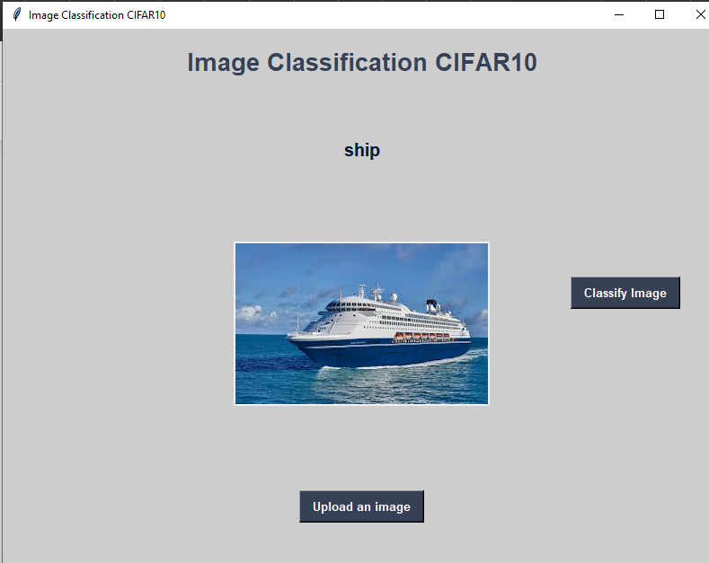
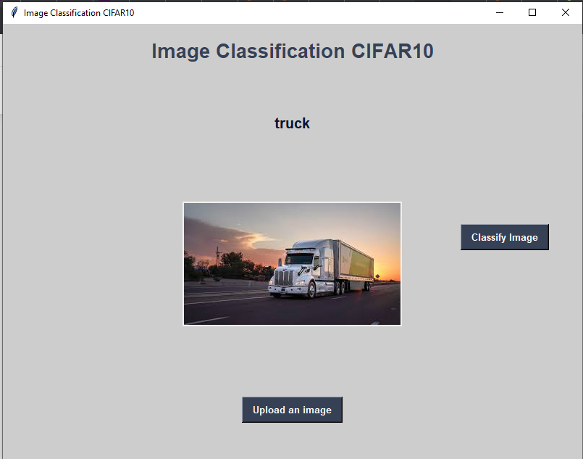

Slide 10
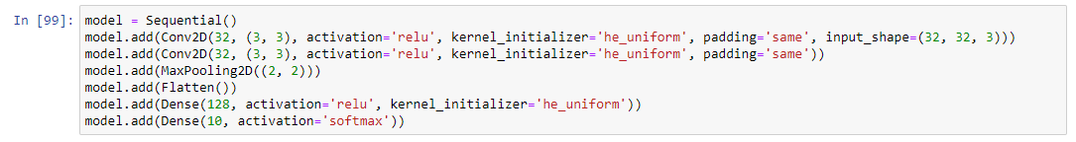
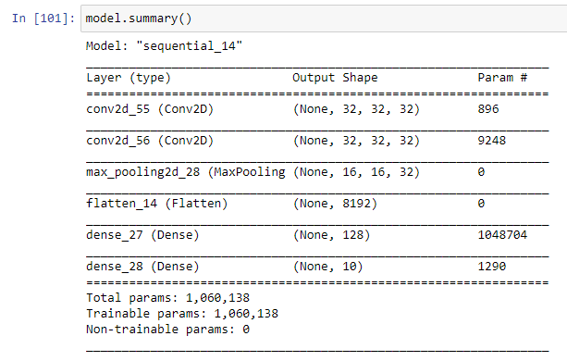
Other networks

Slide 11
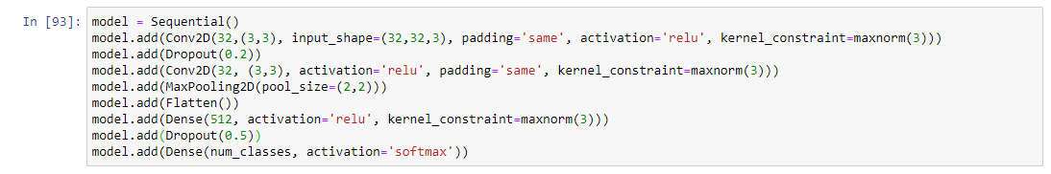
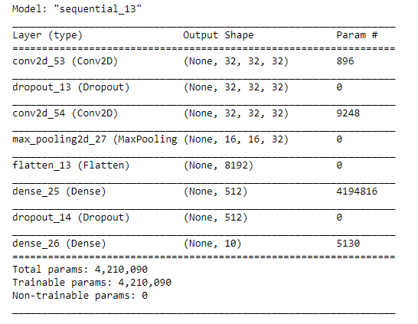

Slide 12
References
https://keras.io/guides/sequential_model/
https://keras.io/api/datasets/cifar10/
https://data-flair.training/blogs/image-classification-deep-learning-project-python-keras/
https://keras.io/api/layers/regularization_layers/dropout/
https://keras.io/api/optimizers/sgd/
https://www.quora.com/What-is-the-VGG-neural-network

Slide 13
Thank you

